Slide 1

Brain Tumor Segmentation Based on MRI Images
Imaging for the Life Science
Guansheng Du
30.05.2024

Slide 2
Introduction
Prevalence of Brain Tumors
Approximately 11,700 new brain tumor diagnoses occur annually in the U.S.
The 5-year survival rate for brain tumor patients is around 35%.
Importance of Timely and Accurate Diagnosis
Early and precise diagnosis can significantly improve treatment planning and outcome predictions.
Current Diagnostic Techniques
Magnetic Resonance Imaging (MRI) is the primary method for diagnosing brain tumors.
MRI scans generate a vast amount of image data, posing significant challenges in analysis due to the complexity of the images and the extensive time required for manual examination by experts.
Advancements in Image Analysis
Recent years have seen the application of deep learning techniques to enhance the analysis of MRI images, aiming to overcome limitations associated with human error and the intensive labor of manual analysis.
Project Focus
This project develops and utilizes a deep learning-based model to segment brain tumor images, aiming to provide more accurate, efficient, and consistent diagnostic results.

Slide 3
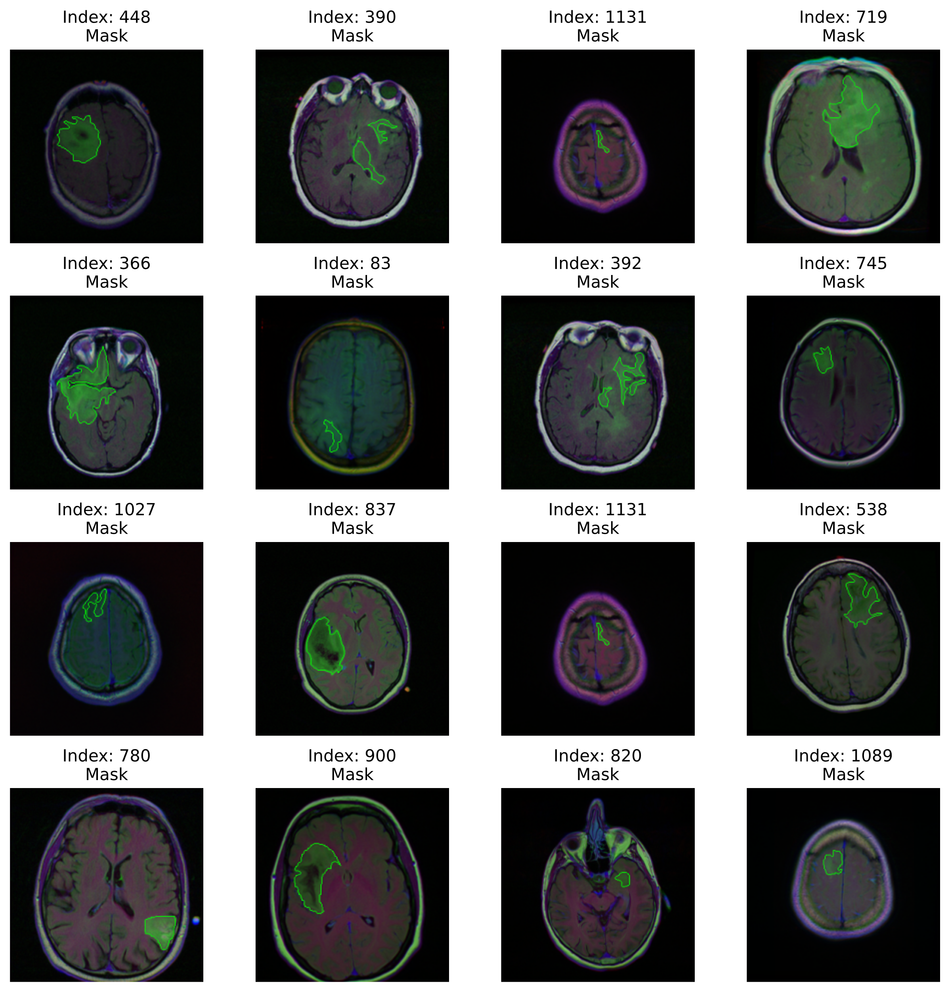
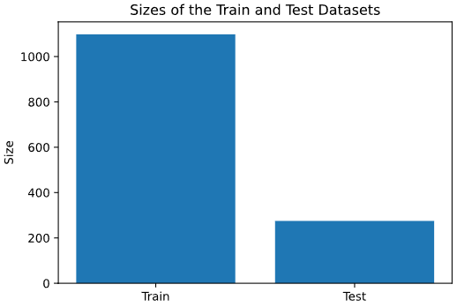
Dataset
Data source: https://www.kaggle.com/datasets/mateuszbuda/lgg-mri-segmentation

Slide 4
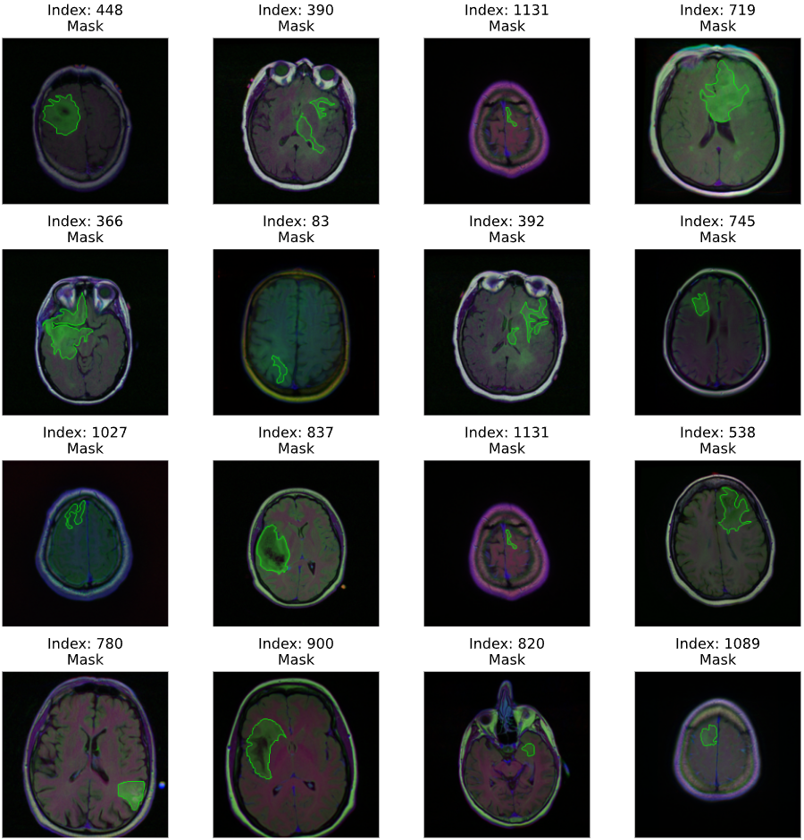
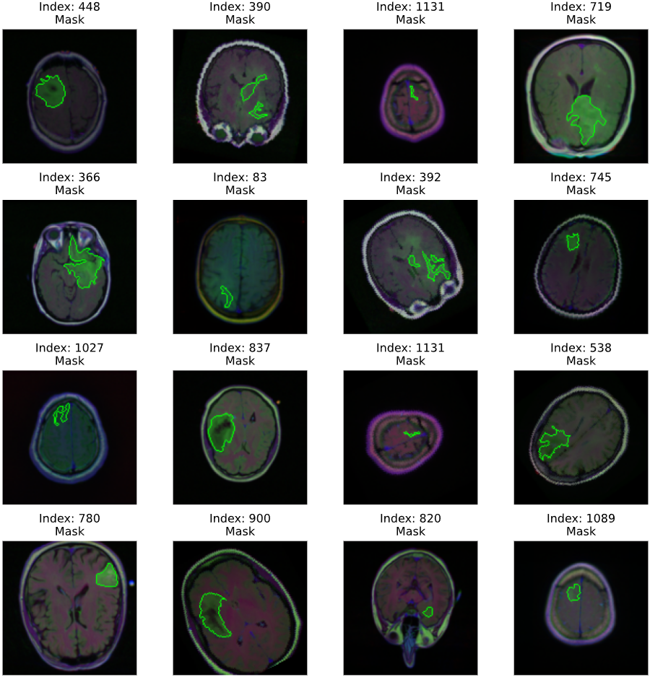
Image augmentation
Resize to 128 x 128 pixels
50% Vertical Flip
50% Vertical Flip
50% 90º Rotation

Slide 5
Training Models
Images 128x128x3
Conv2D 128x128x1
Conv2D 3x3,128x128x64
Conv2D 3x3,128x128x64
Conv2D 3x3,128x128x64
Concatenation
Conv2D 3x3,128x128x64
Max pooling 2x2, 64x64x64
Max pooling 2x2, 64x64x64
Conv2D 3x3, 64x64x128
Conv2D 3x3, 64x64x128
Conv2D 3x3, 64x64x128
Conv2D 3x3, 64x64x128
Max pooling 2x2, 32x32x128
Max pooling 2x2, 32x32x128
Conv2D 3x3, 32x32x256
Conv2D 3x3, 32x32x256
Conv2D 3x3, 32x32x256
Conv2D 3x3, 32x32x256
Max pooling 2x2, 16x16x256
Max pooling 2x2, 16x16x256
Conv2D 3x3, 16x16x512
Conv2D 3x3, 16x16x512
Model architecture: U-Net network
Loss function: Dice Loss
Optimizer: Adam
Learning step: 0.001
Training time: approx. 60 mins on GPU
Conv2D 3x3, 16x16x512
Conv2D 3x3, 16x16x512
Max pooling 2x2, 8x8x512
Max pooling 2x2, 8x8x512
Conv2D 3x3, 8x8x512
Conv2D 3x3, 8x8x512

Slide 6
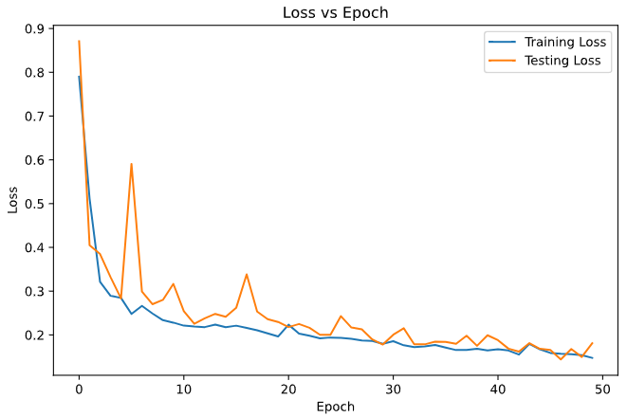
Loss History

Slide 7
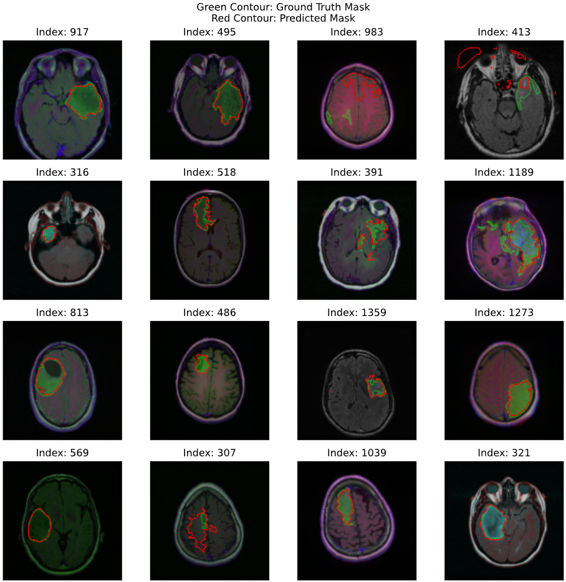
Evaluation

Slide 8
Discussion and Next steps
Conclusion
The U-Net model demonstrates considerable potential in segmenting gliomas from MRI images, indicating a strong foundation for further refinement and application in clinical settings.
Next Steps
Optimize image preprocessing techniques to improve model accuracy.
Experiment with different loss functions to find the most effective for this specific segmentation task.
Expand the model’s training to include images without tumors to evaluate its diagnostic accuracy comprehensively.

